Slide 1
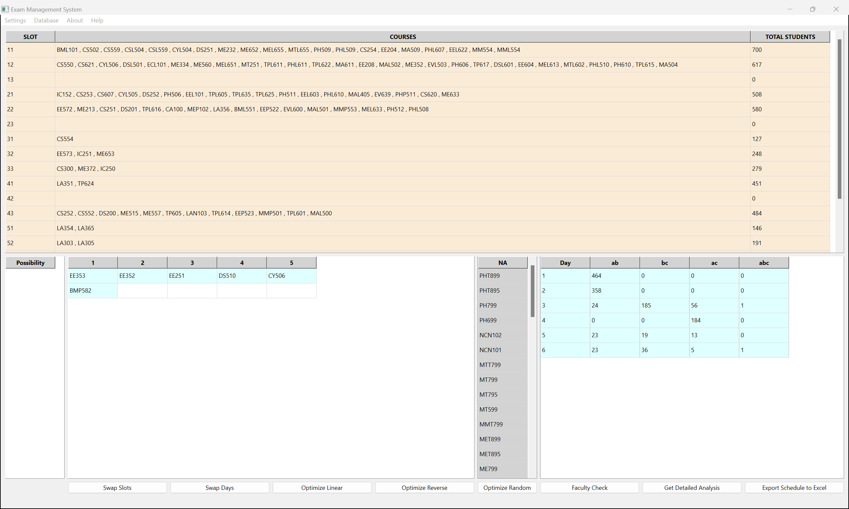
Exam Scheduling Software
By Shubham Yogesh Mahajan (12241730) a BTech student in the discipline of CSE

Slide 2
1st February 2024
Motivation
After encountering a hectic mid semester examination schedule , I visited the Office of Academic Affairs as the Class Representative of CSE’26 batch.
I observed that the prevailing practice of creating the time table for exams was done entirely manually using excel spreadsheets.
Any changes in the time table required the staff to perform tedious , repetitive operations in the vast excel workbook
This prompted me to develop a software that could help create the exam time table optimally and efficiently.

Slide 3
Where did the old method lack?
Previously the exam scheduling was done entirely manually using excel spreadsheets
Extremely tedious and time consuming
Repetitive
There was no way of knowing how many and, which students will have to attempt more than one exam in a day.
No optimization possible due to lack of data
No convenient way of knowing how the presence of a particular course affects the overall Time Table.
No possible slots for scheduling are known before hand thus, making the process of scheduling a course a very difficult, and exhausting hit and trial process.
No convenient record of which courses are scheduled and which are yet to be scheduled, thus requiring constant manual verification.
High Scope for manual errors
Incorporating any suggestions extremely tedious, as the ripple effect of changes can’t be anticipated
Unorganized

Slide 4
How will the Software help?
1) Easy to use and extremely fast
2) The software handles all the repetitive and tedious tasks by providing complete automation
3) Simplified User interface allows an organized, and efficient method of creating the Schedule
4) Detailed analysis given about students who have to attempt more than one exam in a day
5) One-Click Optimization possible due to presence of accurate data
6) The effect a course will have on the overall time table can be easily determined
7) With a simple click you get all the possible slots in which a particular course can be scheduled.
8) Tables present to keep track of all the scheduled and unscheduled courses
9) Little to no possibility of manual errors due to automated processes.
10) Incorporating changes and suggestions extremely easy due to fast and accurate algorithms

Slide 5
Features and Functionality
1) A User Friendly Interface
2)Settings to control number of days of the exam and the max capacity of lecture halls.
3) Automatic Generation of the exam time table with further optimization options
4) Analysis
5) Scheduling mechanism which includes student clash detection as well as max capacity change feature
6) Descheduling mechanism
7) Facility to find alternate slots
8) Optimization
9) Facility to Swap exam days and swap exam slots
10) Faculty report generation which reflects the workload on the faculties
11) Feature to export the created schedule to excel

Slide 6
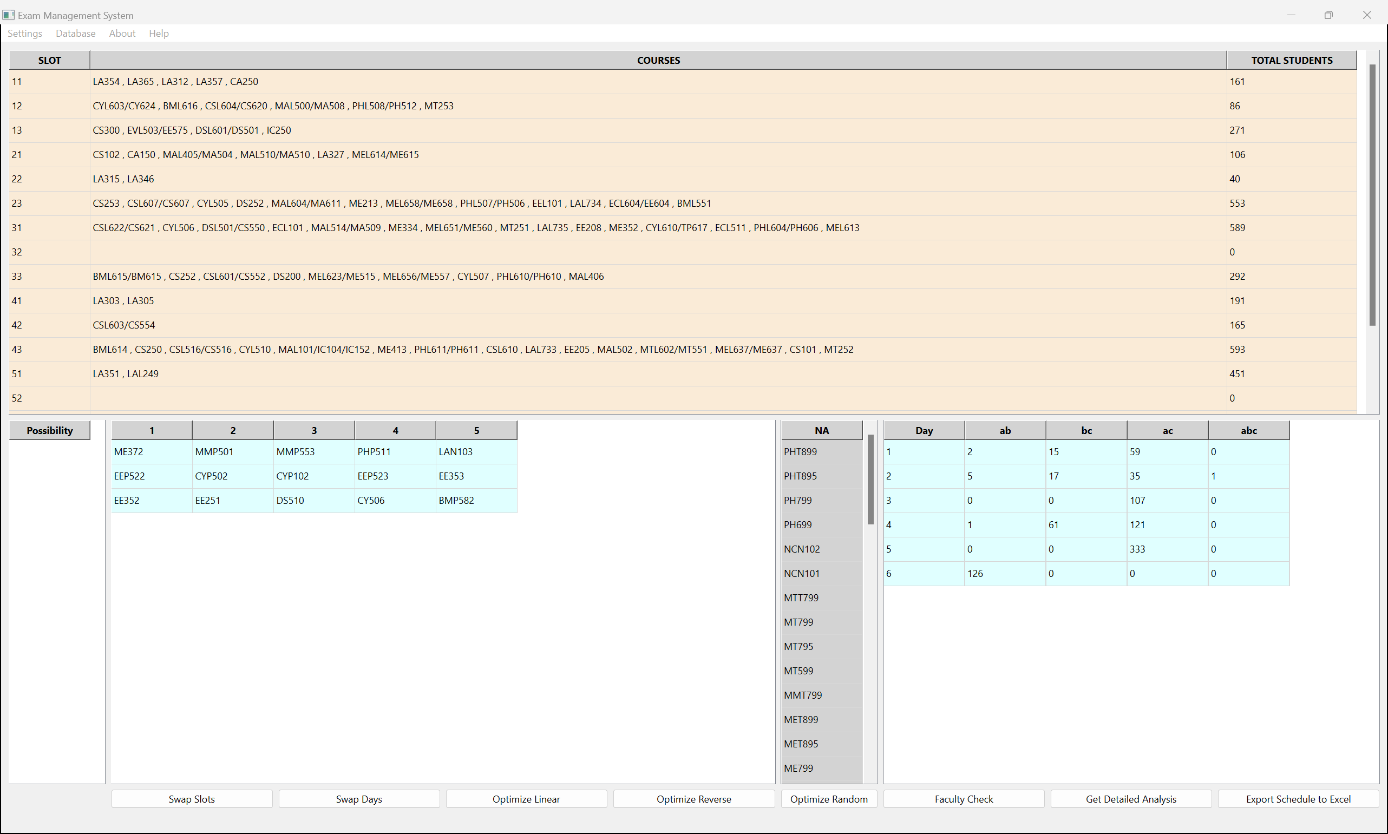
A User Friendly Interface
A graphical user interface allows the entire operations of exam scheduling to be performed using a single, easily understandable window .
Features & Functionality

Slide 7
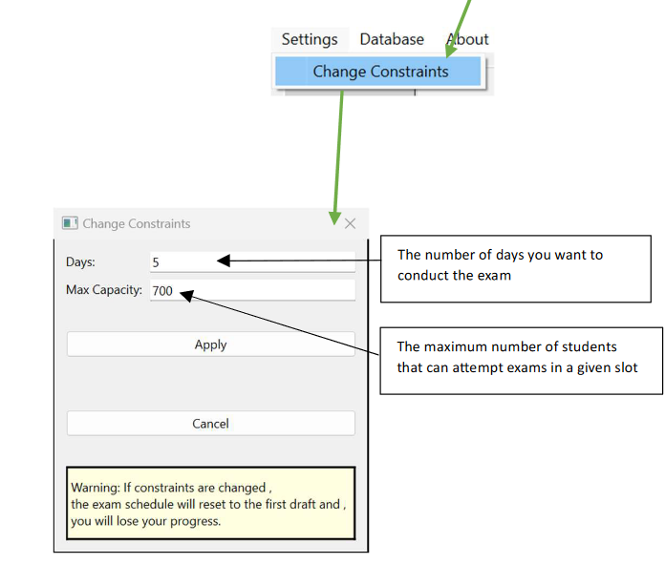
Settings
The user has control over the following constraints:
Number of days the exam will be conducted for
The maximum number of students that can give exam in a particular slot.
Features & Functionality

Slide 8
Automatic Generation of the Timetable
Based on the given input and constraints the software automatically creates a valid timetable for the exams using a special algorithm.
It is ensured that –
No student will have to give more than one exam in a particular slot ( Conflict Prevention )
The Maximum Capacity defined will be followed for each slot ( Constraints implementation)
This First Draft can be conveniently modified to ensure that no student is overloaded on any given day ( discussed later)
Features & Functionality

Slide 9
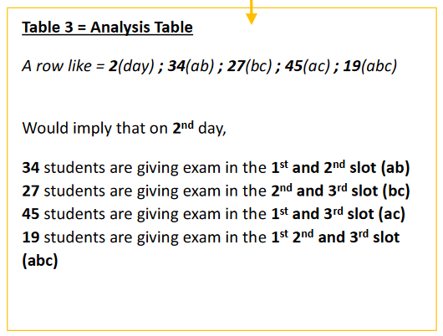
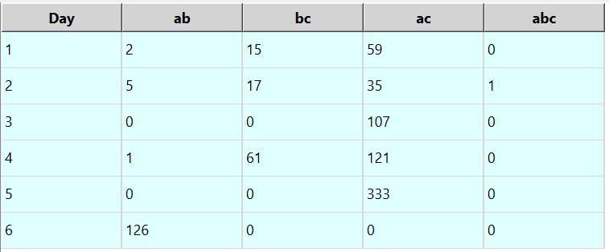
Live Analysis
The user will always know the exact number of students who have to give more than one exam in a day with the help of the analysis table.
Features & Functionality

Slide 10
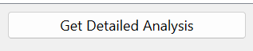
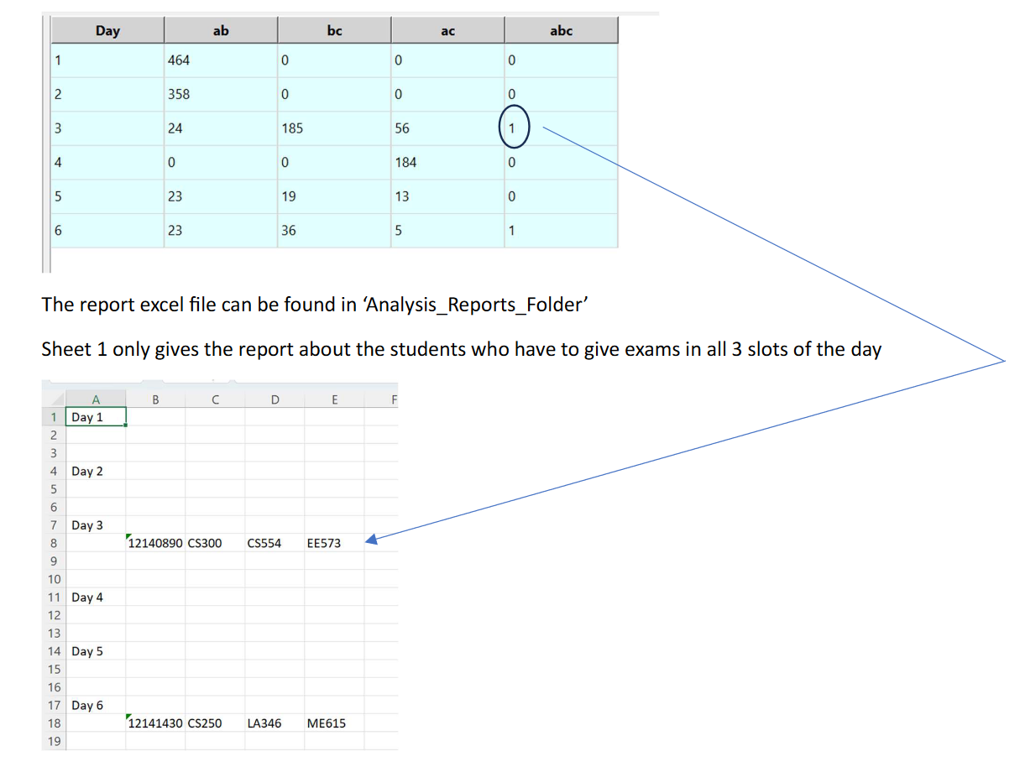
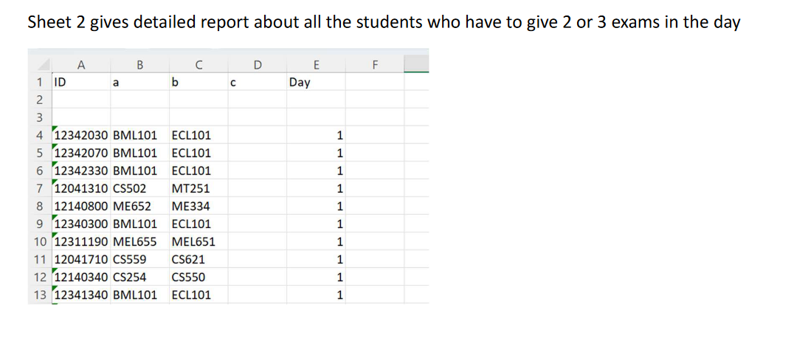
Detailed Analysis
With the click of a button, the user can obtain a detailed report of the data present in the “Analysis Table”
Features & Functionality

Slide 11
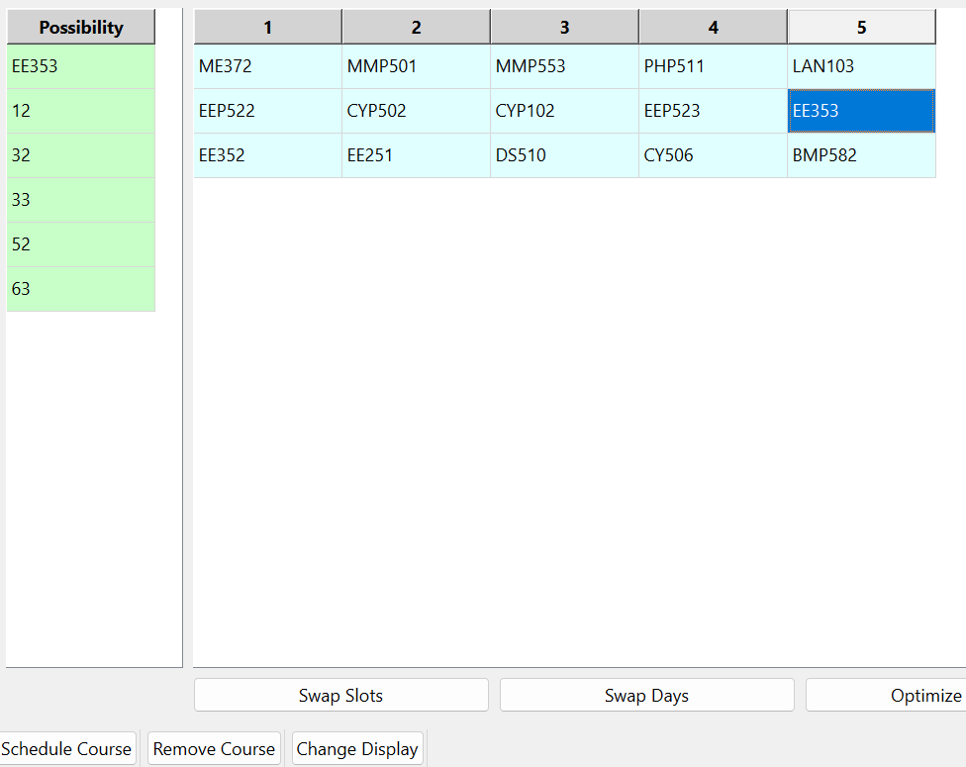
Scheduling of a course
With simply 4 clicks the user can schedule a course and, even understand how scheduling that course in that particular slot affects the overall Time Table.
Overview of the Scheduling Process:
1) Select the course you want to schedule
2) The slots which are possible for scheduling appear.
(displayed slots won’t have student conflicts)
3) Click “Schedule Course”
Features & Functionality

Slide 12
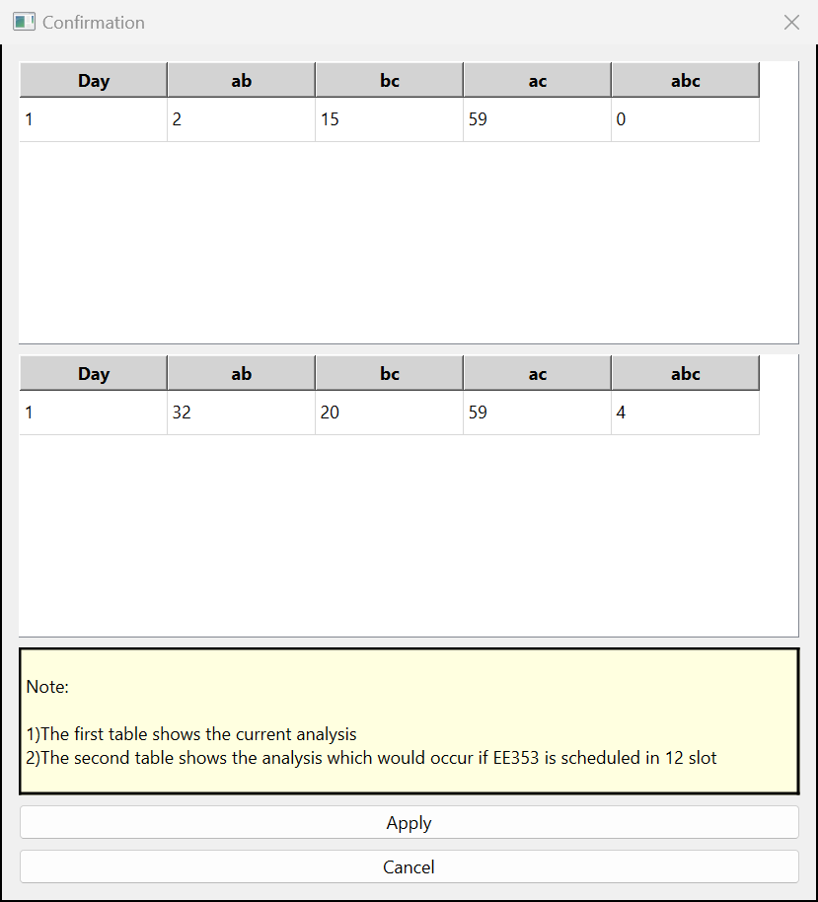
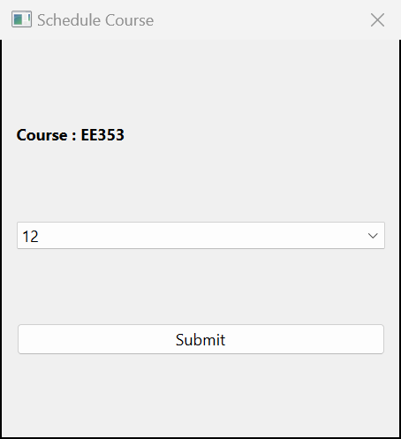
5) Confirmation Dialog Box appears if :
a)there are no student conflicts
b)the max capacity specified is not being exceeded
The confirmation dialog box shows how scheduling the course in the chosen slot will affect the overall exam Time Table
4)Choose the appropriate slot from the dropdown and click Submit
6) Click Apply to Schedule the course
Features & Functionality

Slide 13
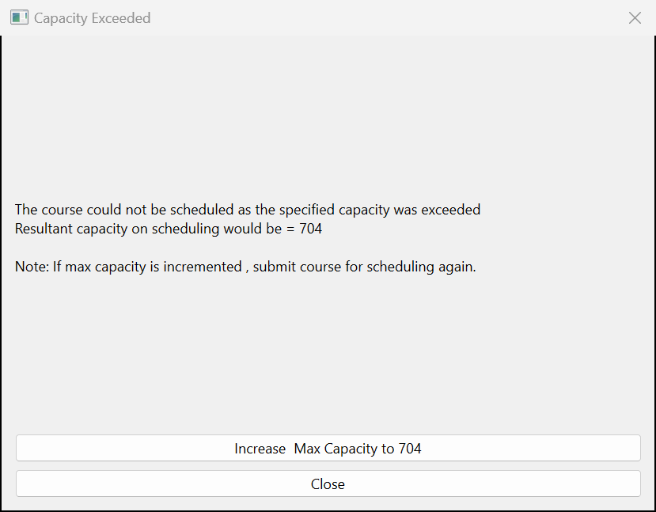
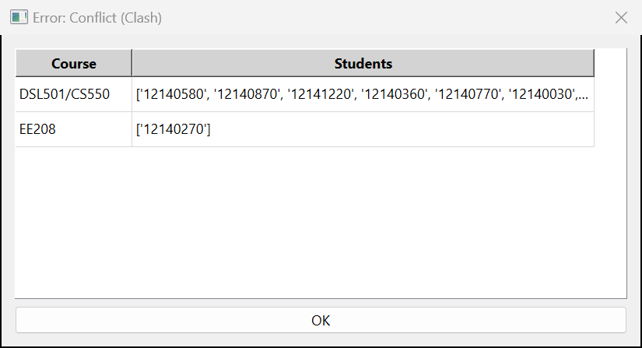
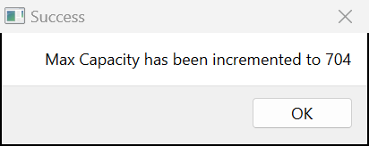
Student Conflict Example:
Attempting to schedule EE353 in 31 slot
Capacity Exceeding Example
Attempting to schedule PHT899 in slot 53
This implies that 12140270 is enrolled in both EE208 and EE353 and thus, we can’t schedule EE353 in 31 as EE208 is already present in that slot
In case a slot is chosen which raises a student conflict , a detailed summary is given –
The IDs of the student
The course in the slot in which the conflicting student in enrolled
An option provided to allow users to increase the max capacity conveniently
Features & Functionality

Slide 14
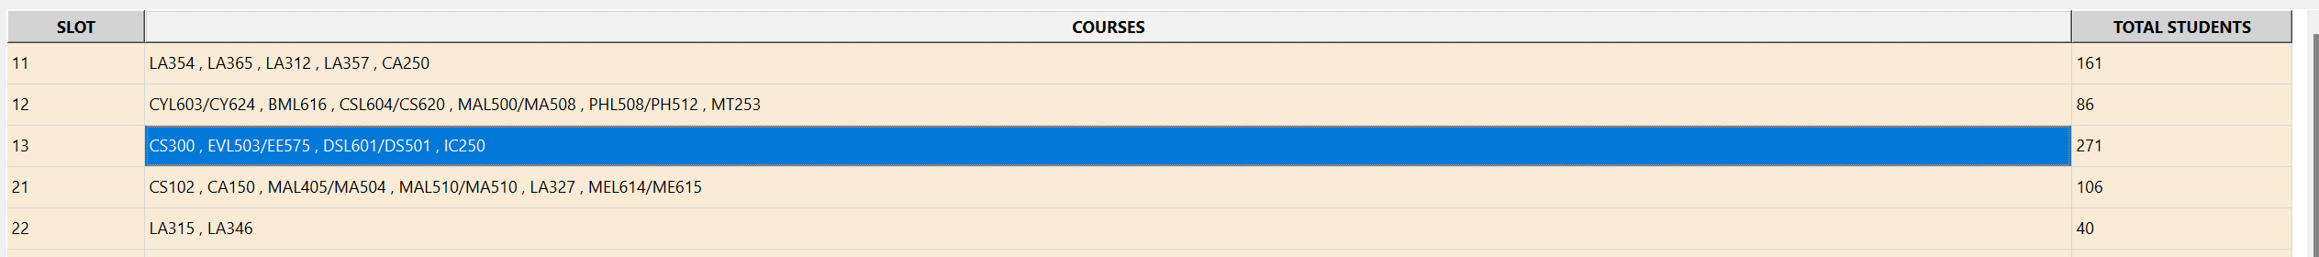
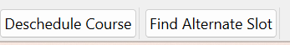
De-scheduling a course
With simply 3 clicks the user can de-schedule a course and observe its overall effects on the Time Table
Overview of the De-scheduling Process:
1) Select the slot from which you wish to de-schedule a course
2) Click the “De-schedule Course” button
Features & Functionality

Slide 15
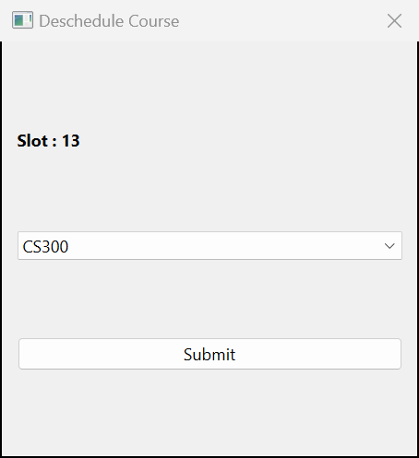
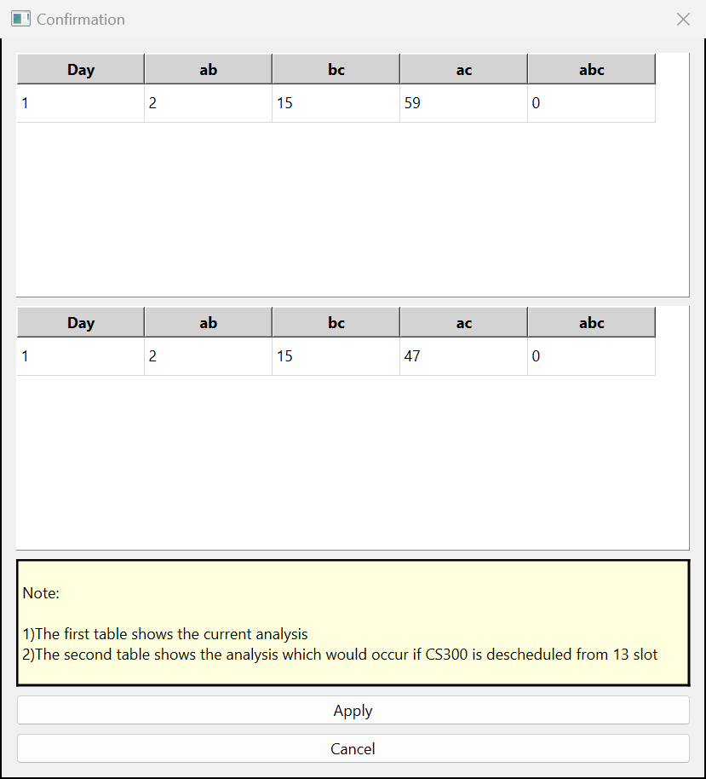
Confirmation Dialog Box appears
3) Select the course you want the de-schedule from the drop down and click Submit
4) Click “Apply” to de-schedule the course
Features & Functionality

Slide 16
Finding Alternate Slots for a Course
The user can find alternate slots for a scheduled course to explore alternate possibilities
1) Select the slot in which the course is present
2) Click the “Find Alternate Slot” button
Features & Functionality

Slide 17
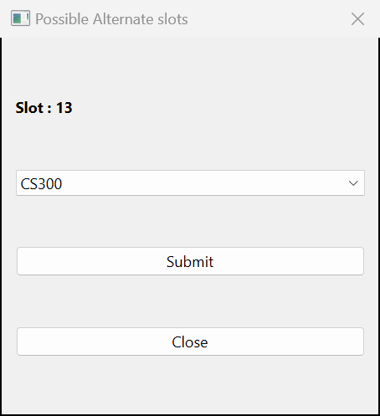
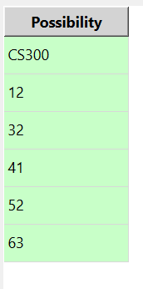
The alternate scheduling possibilities for the course are shown.
(the displayed slots won’t have student conflicts)
3) Choose the desired course from the dropdown and click submit
Features & Functionality

Slide 18
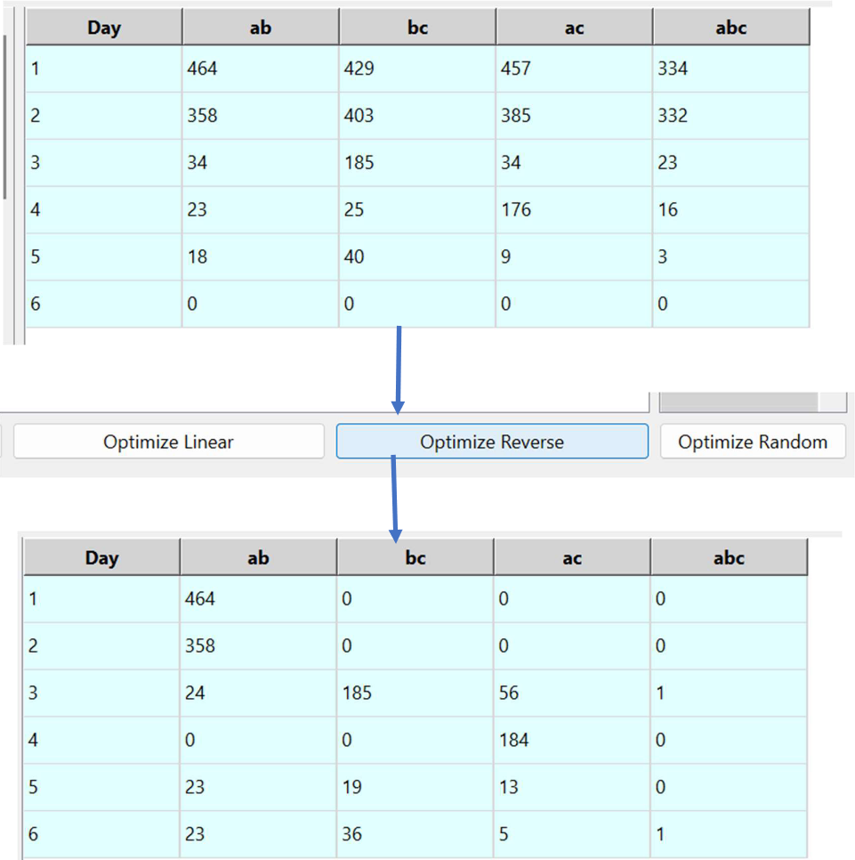
Optimization
With the click of a button the user can minimize the number of students who have to give 3 exams in a day
Optimization is done using a special “Greedy” Algorithm
Features & Functionality

Slide 19
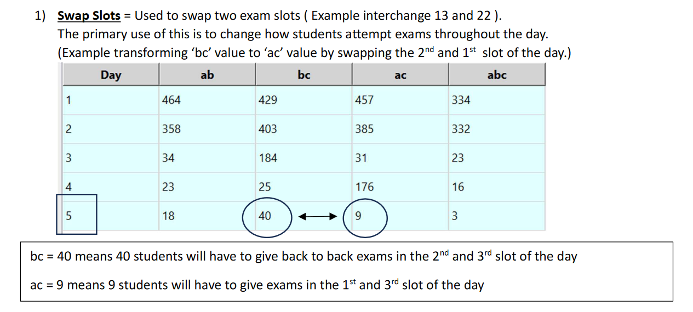
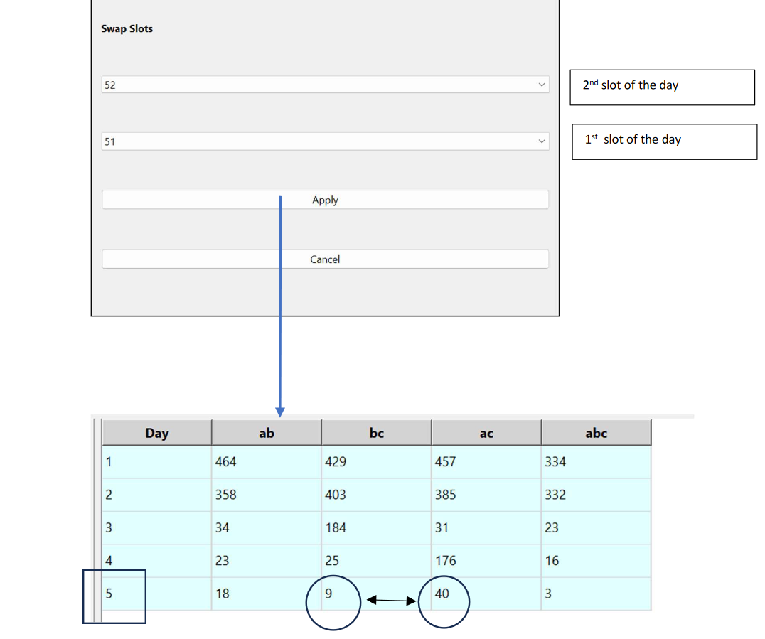
Swap Slots Feature
The user has complete control over how students attempt exams throughout the day.
Features & Functionality

Slide 20
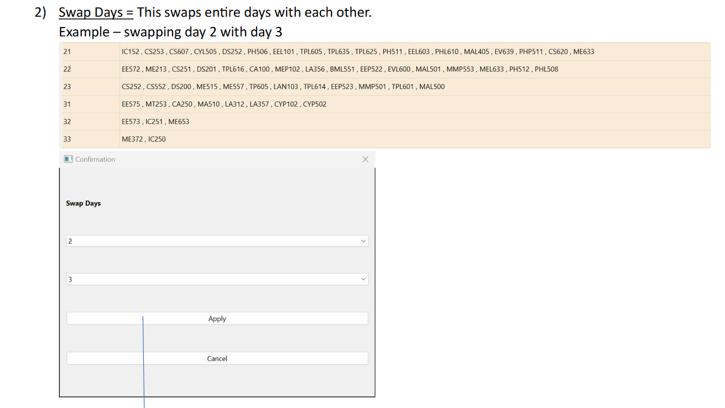
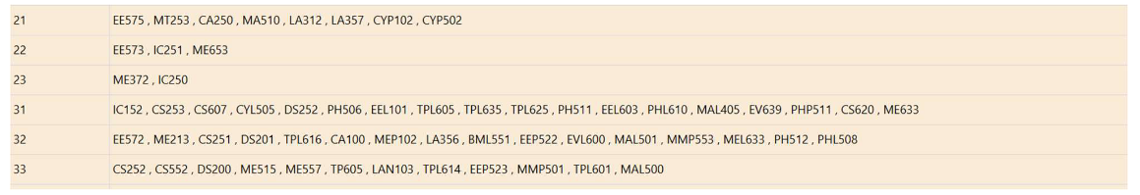
Swap Days Feature
The user has control over the workload distribution throughout the examinations
Features & Functionality

Slide 21
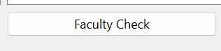
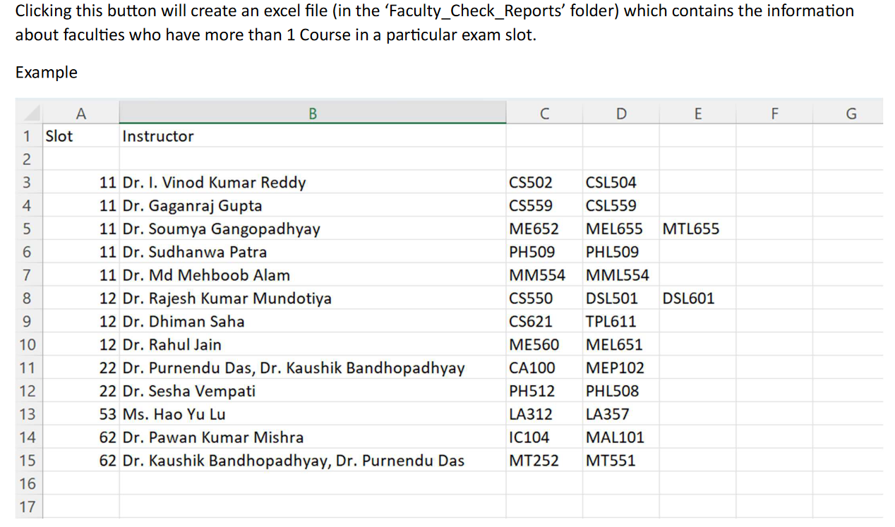
Faculty Workload Report
This feature can be used to ensure that no faculty is overloaded on any given day
Features & Functionality

Slide 22
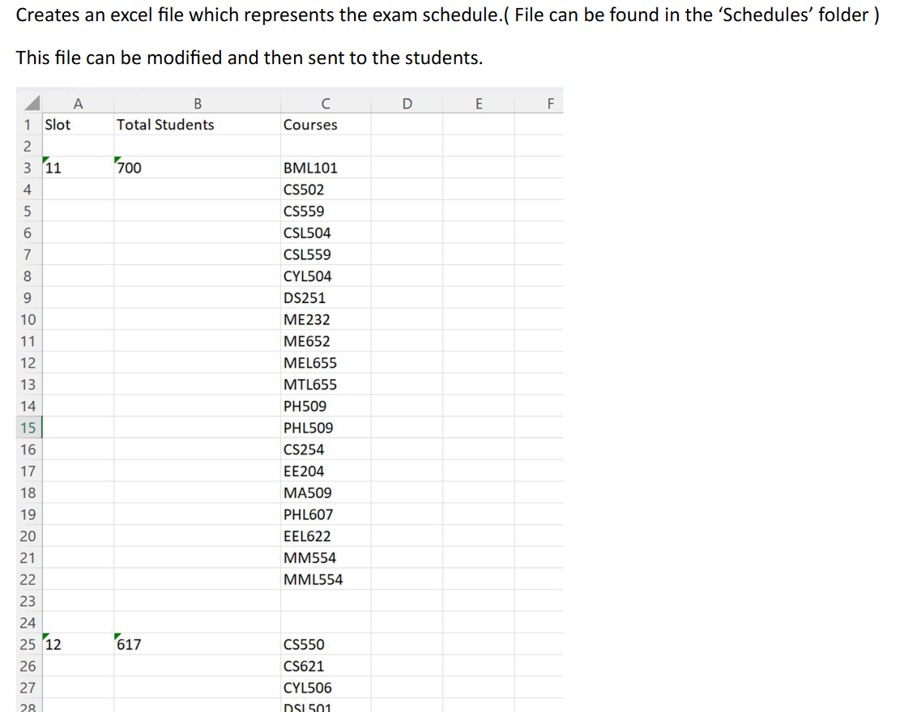
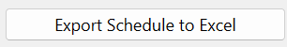
Export Schedule to Excel
Features & Functionality

Slide 23
The numbers don’t lie
The End Semester examination Time Table was created using the “Exam Scheduling Software”
1) It took more than 4 days to create the Mid Semester Examination Time Table, whereas the End Semester Examination was made in under 4 hours using the software !
2)Due to lack of optimization in the first version of the Mid Semester Exam Timetable more than 200 students had to give 3 exams in a single day.
Using the special optimization algorithms of the software this number was reduced to 0. Not a Single student had to give 3 exams in a single day in the End Semester Examinations.

Slide 24
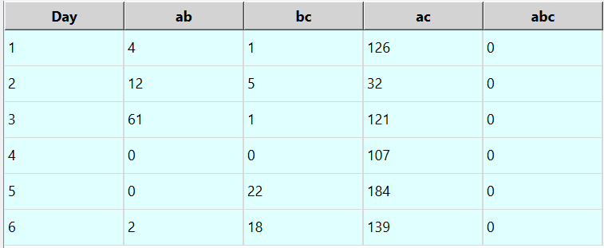
An Example of the benefits
The software analysis helped the staff to reduce the examination workload for the students
The schedule was planned in such a way that the majority of the students who had to attempt 2 exams in a day were given a sufficient break between the two papers

Slide 25
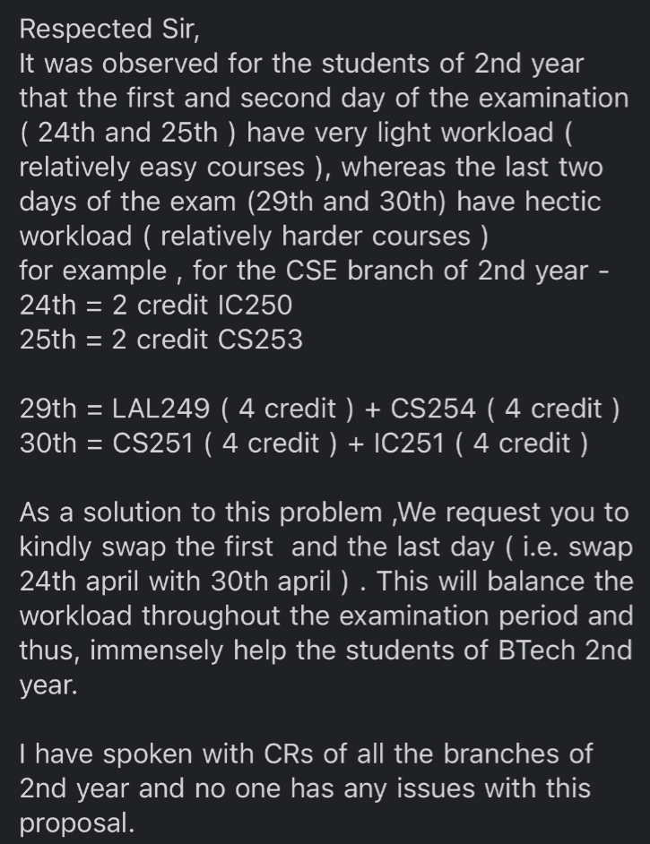
An Example of the benefits
The software helped in prompt incorporation of suggestions and changes in the End Semester examination Time Table
Example:
The presence of detailed analysis helped the staff to determine if the change is feasible.
The verification took less than 3 minutes.
This change was then applied in under 30 seconds by simply using the “Swap Days” feature of the software !

Slide 26
An Example of the benefits
After the first version of the End Sem TT was drafted a logistics issue prompted the academics to shift an entire exam slot.
Such a shift can have cascading effects on the entire schedule.
This seemingly humongous task was just a matter of 20 mins for the academic staff using the software .
They were quickly able to identify the slots which could be swapped and the courses which could be shifted with the help of the robust analysis provided by the software.

Slide 27
The Outcome
This software not only helps the Office of Academic affairs but also the Students and the Faculties of IIT Bhilai.
A Staff with better control over the time table would result in a better situation for the students and the faculties alike.
A Time Table which is balanced and not hectic for the students is now not just a fantasy, but a reality which can be achieved using this software

Slide 28
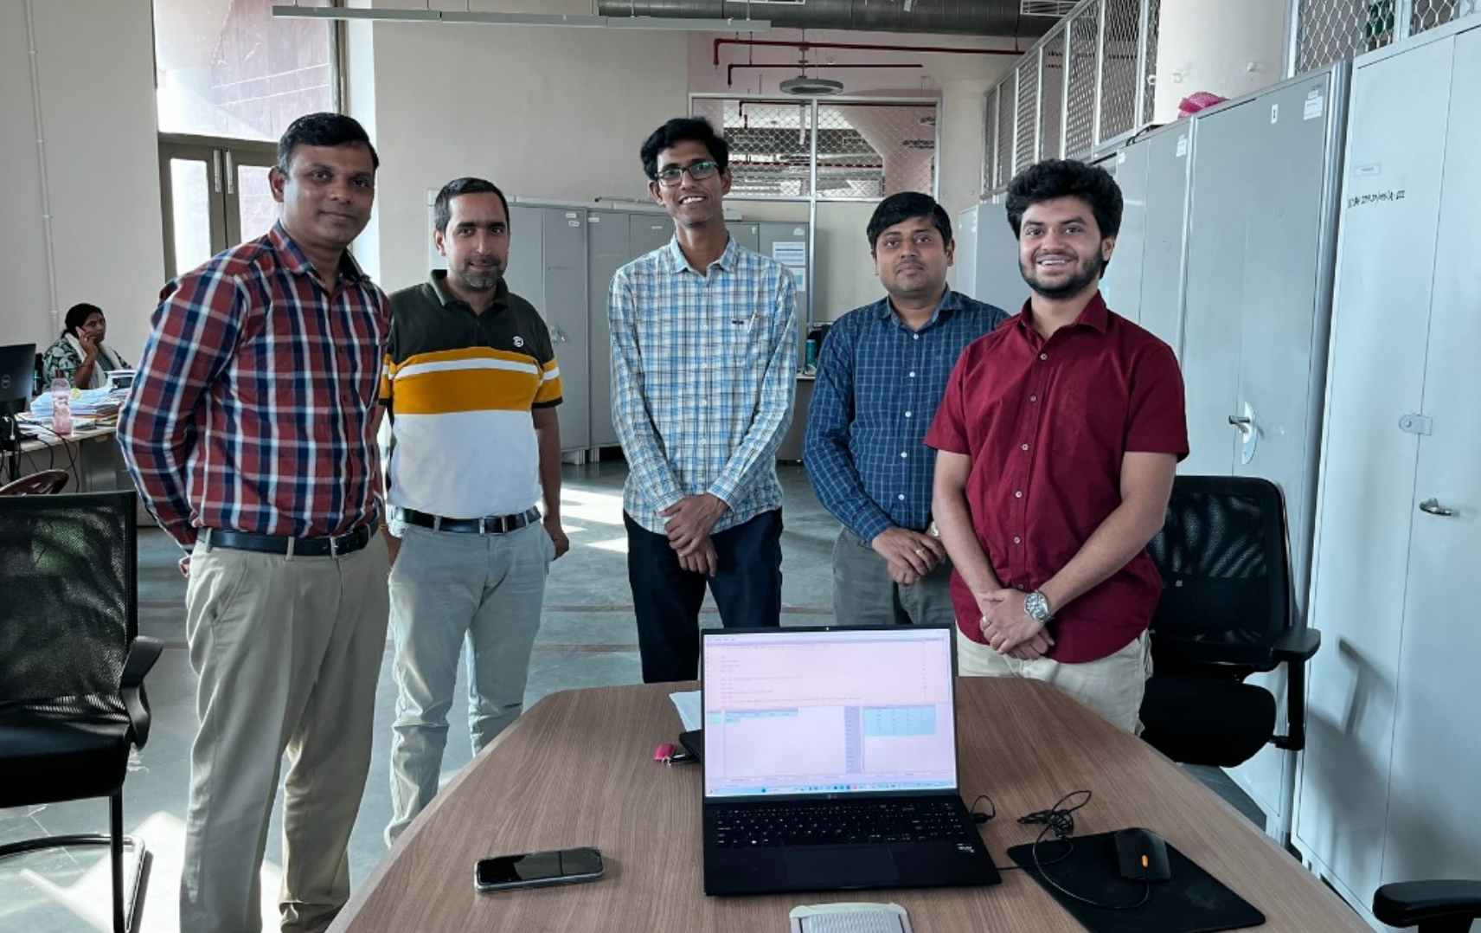
Special Mentions
I extend my sincere gratitude to Mr. Pawan Kumar Mishra, Assistant - Office of Academic Affairs for his invaluable guidance throughout the development of this software. His profound insights played a pivotal role in defining the features and functionalities of the software.
I deeply appreciate the support shown by the Office of Academic Affairs – IIT Bhilai. Their collective expertise and encouragement have been instrumental throughout the development journey of this software .

